Slide 1
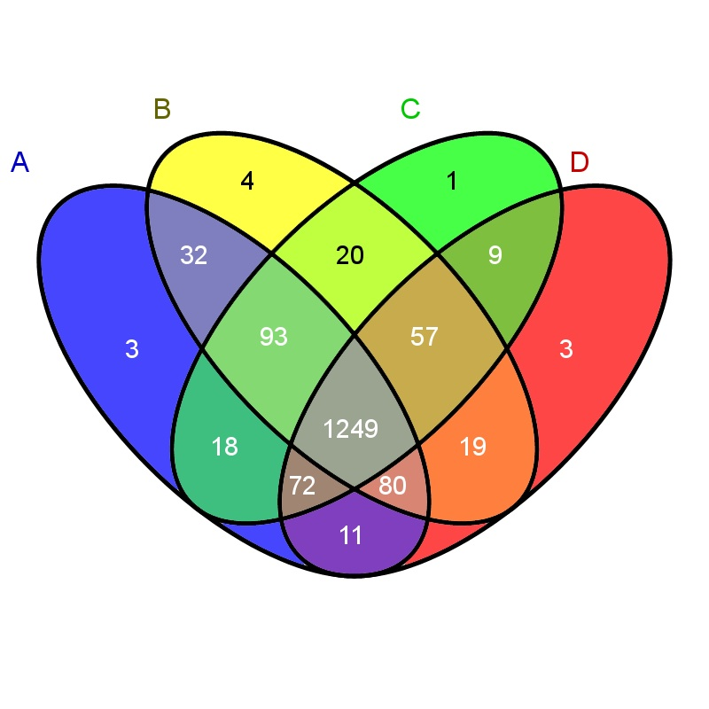
B
C
A
D
Notes:
Biological replicates comparison of proteins identified (orbitrap)

